Slide 1

Machine Learning & AI in .NET Beginner Series
Series Intro
Luis Quintanilla

Slide 2

Introduction

Slide 3
What will you learn?
Introduction to AI & ML
Generative AI (OpenAI)
Intro to ChatGPT
Prompts & Prompt Engineering
Use ChatGPT with your data
ChatGPT Plugins
AI Services
Consume AI Services models
Train custom AI Services models
ML.NET
Intro to ML.NET
Automated ML
Train custom ML models
Deploy custom ML models

Slide 4
Samples: aka.ms/dotnet-ai-beginner

Slide 5
Introduction to AI & ML

Slide 6
What will you learn?
What is AI & ML
What can you do with AI & ML?
AI & ML for .NET Developers

Slide 7
What is AI and ML?
Artificial Intelligence (AI)
Machine Learning (ML)
Deep Learning
Generative AI
Artificial Intelligence (AI)
Agents automating tasks typically performed manually by humans
Machine Learning (ML)
Systems that use algorithms and data to infer patterns
Deep Learning
ML technique that uses algorithms known as neural networks
Generative AI
Use of deep learning algorithms to generate new content (text, images, etc.)

Slide 8
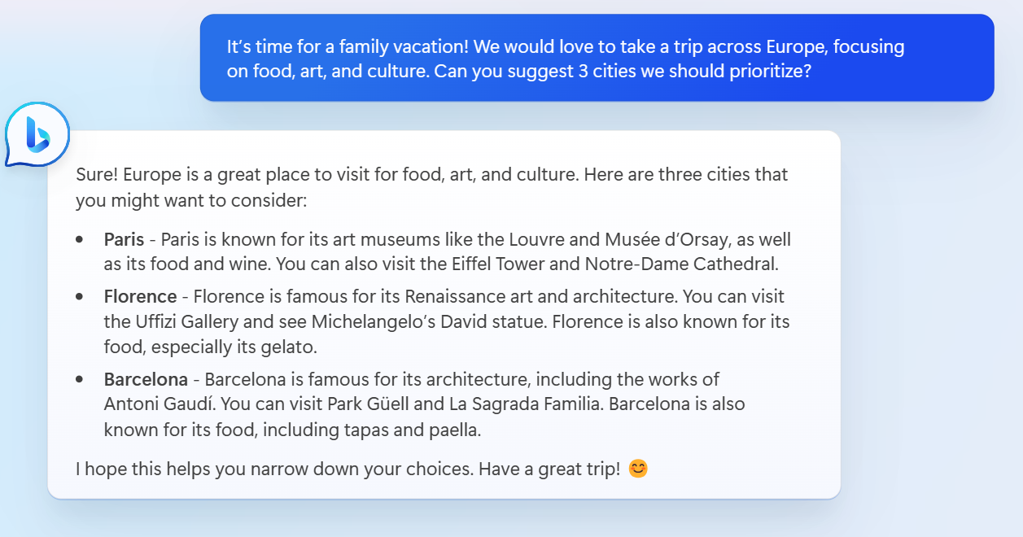
What can you do with AI & ML?
Language
Analyze sentiment of customer reviews
Virtual Agents / Chatbots
Translate text or code
Explaining code
Computer Vision
Identify objects in an image or video
Classification
Label the severity of a customer reported issue
Anomaly Detection
Predictive maintenance
Forecasting
Quarterly sales

Slide 9
AI & ML for .NET Developers
Services
Azure Open AI
Azure AI Services
Frameworks & Libraries
Semantic Kernel
ML.NET
Automated Machine Learning (AutoML)
TorchSharp
SciSharp (TensorFlow.NET)
Open Neural Network Exchanges (ONNX)
Plotly.NET
Tools
Model Builder
ML.NET CLI
Polyglot Notebooks

Slide 10
What you learned?
What is AI & ML
What can you do with AI & ML?
AI & ML for .NET Developers

Slide 11
Introduction to ChatGPT

Slide 12
What will you learn?
What is ChatGPT?
ChatGPT Roles
Chat / Message History
Use ChatGPT with .NET

Slide 13
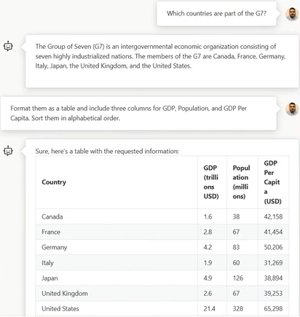
What is ChatGPT?
General Pretrained Transformers (GPT) is a general-purpose Generative AI model that can be used for a wide range of language-related tasks.
ChatGPT builds in top of it and is designed for conversational tasks
Roles
Chat / Message History

Slide 14
ChatGPT Roles
System
Provides guidance for the assistant, defines its capabilities, limitations, and behavior.
It sets the rules and instructions at the assistant follows when generating responses to the user’s input.
User
The user is the person or system interactive with the assistant, providing input and receiving responses.
Assistant
The assistant is the AI chatbot itself, which uses GPT’s language model to generate responses to the user’s input in a conversational manner.

Slide 15
Chat / Message History as context
Context in ChatGPT refers to historical information or any relevant details that guide its response.
Context provides better user experiences by having context for further conversations and generating more accurate / relevant responses.
Chat / message history is a way to provide context to ChatGPT.

Slide 16
Samples: aka.ms/dotnet-ai-beginner

Slide 17
What you learned?
What is ChatGPT?
ChatGPT Roles
Chat / Message History
Use ChatGPT with .NET

Slide 18
Prompts & Prompt Engineering

Slide 19
What will you learn?
What are prompts and prompt engineering?
Anatomy of a prompt
Tips for improving prompts
Apply prompt engineering techniques to ChatGPT

Slide 20
What are prompts and prompt engineering?
Prompt – A statement or question that is used to generate a response from a language model. The prompt is the input that the model receives, and the response is the output generated by the model.
Prompt Engineering – Prompt engineering is the process of creating and improving prompts. The goal is to make prompts that are clear and unambiguous. By doing so, models are more likely to generate more relevant and detailed responses.

Slide 21
The anatomy of a prompt
Question / Instruction – Defines behavior
Context – Provides relevant details
Examples – Provides additional guidance on formatting the response

Slide 22
Tips for improving prompts
Be clear and specific
Include examples
Provide relevant context
Experiment and refine

Slide 23
Samples: aka.ms/dotnet-ai-beginner

Slide 24
What you learned?
What are prompts and prompt engineering?
Anatomy of a prompt
Tips for improving prompts
Apply prompt engineering techniques to ChatGPT

Slide 25
Add context to your chat

Slide 26
What will you learn?
Context sources
Introduction to Retrieval Augmented Generation (RAG) pattern
Using ChatGPT to answer questions about your data

Slide 27
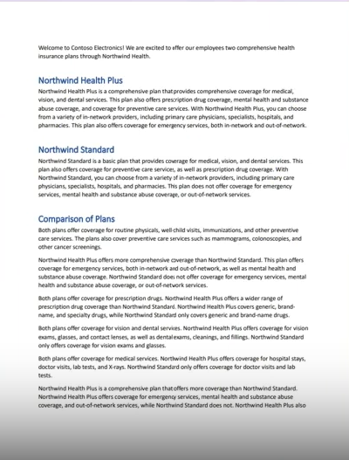
Context sources
Chat / Message History
User: Hi, can you tell me about the weather in Seattle today?
Assistant: Hello! According to the latest weather reports, it is currently cloudy with a high of 65F and a low of 55F in Seattle. There is a chance of rain later in the dat. Would you like more detailed information or a forecast for the coming days?
Sample responses
(few-shot learning)
Extract the airport codes from this text:
Text: “I want to fly from Los Angeles to Miami”
Airport codes: LAX, MIA
Data & documents

Slide 28
What you learned?
Context sources
Introduction to Retrieval Augmented Generation (RAG) pattern
Using ChatGPT to answer questions about your data

Slide 29




Introduction to Retrieval Augmented Generation
Users submit question / instructions
A query is performed on the data sources to retrieve the most relevant documents
A prompt is created containing the user question / instruction + retrieved documents
The prompt is submitted to ChatGPT to generate a response
Response is returned back to the user
Retrieve
Data Sources
Application / Function
Augment
Language
Model
(ChatGPT)
Generate

Slide 30
Samples: aka.ms/dotnet-ai-beginner

Slide 31
What you learned?
Context sources
Introduction to Retrieval Augmented Generation (RAG) pattern
Using ChatGPT to answer questions about your data

Slide 32
Introduction to ChatGPT Plugins

Slide 33
What will you learn?
What are ChatGPT Plugins?
Core components of a ChatGPT Plugin
Building and testing ChatGPT Plugins with .NET

Slide 34

What are ChatGPT Plugins?
Tools for Large Language Models like ChatGPT
Help ChatGPT
Access up-to-date information
Run computations
Use third-party services
Web Service

Slide 35
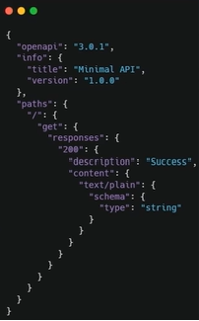
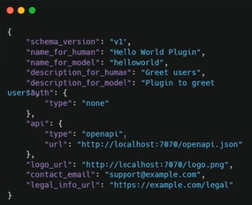
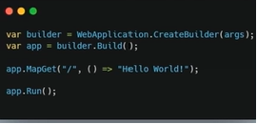
Core components of ChatGPT Plugins
Web Service
OpenAPI specification
Manifest

Slide 36
Samples: aka.ms/dotnet-ai-beginner

Slide 37
What you learned?
What are ChatGPT Plugins?
Core components of a ChatGPT Plugin
Building and testing ChatGPT Plugins with .NET

Slide 38
Introduction to Azure AI Services

Slide 39
What will you learn?
What are Azure AI Services?
What can you do with Azure AI Services
Use AI Services in your .NET applications

Slide 40
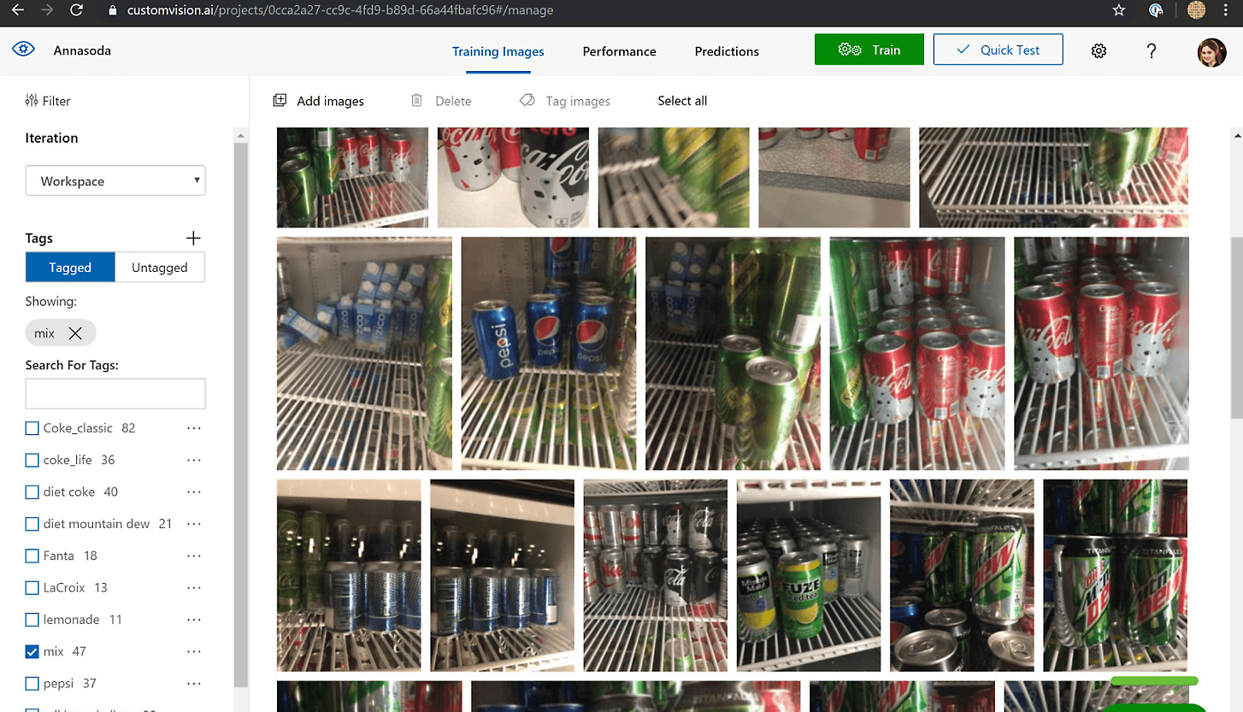
What are Azure AI Services?
Suite of out-of-the-box and customizable
AI tools
APIs
Models

Slide 41
What can you do with Azure AI Services?
Language
Classify, summarize, and extract key insights from text
Analyze sentiment
Vision
Classify and identify objects in images or videos
Object Character Recognition (OCR)
Speech
Speech-to-Text, Text-to-Speech
Recognize speakers
Documents
Detects and extracts texts and layouts from documents, like tables, check boxes, and objects
Decision Support
Detect spikes in energy utilization

Slide 42
Samples: aka.ms/dotnet-ai-beginner

Slide 43
What you learned?
What are Azure AI Services?
What can you do with Azure AI Services
Use AI Services in your .NET applications

Slide 44
Introduction to Azure AI Services

Slide 45
What will you learn?
Why train models?
Train a custom model using Azure AI Services

Slide 46
Why train your own model?
Specialized use case / customization
More efficient responses

Slide 47
Samples: aka.ms/dotnet-ai-beginner

Slide 48
What you learned?
Why train models?
Train a custom model using Azure AI Services

Slide 49
Introduction to ML.NET

Slide 50
What will you learn?
What is ML.NET?
What can you do with ML.NET?
ML.NET Ecosystem

Slide 51
What is ML.NET?
ML.NET is an open-source, cross-platform, machine-learning framework for .NET developers
Runs anywhere .NET runs
On-Prem / Cloud
Windows, Mac, Linux
X64 / ARM64 architectures
Reuse existing knowledge, libraries, and tools you’re already using in .NET to integrate AI into your applications

Slide 52
What can you do with ML.NET?
Consume pre-trained moels
TensorFlow
Open Neural Network Exchange (ONNX)
Train custom models
Classification
Analyze sentiment
Fraud detection
Categorize text
Vision
Classify and detect objects in images
Decision
Detect anomalies (spike in energy demand)
Analytics & Insights
Forecast sales
Customer segmentation
Price prediction

Slide 53
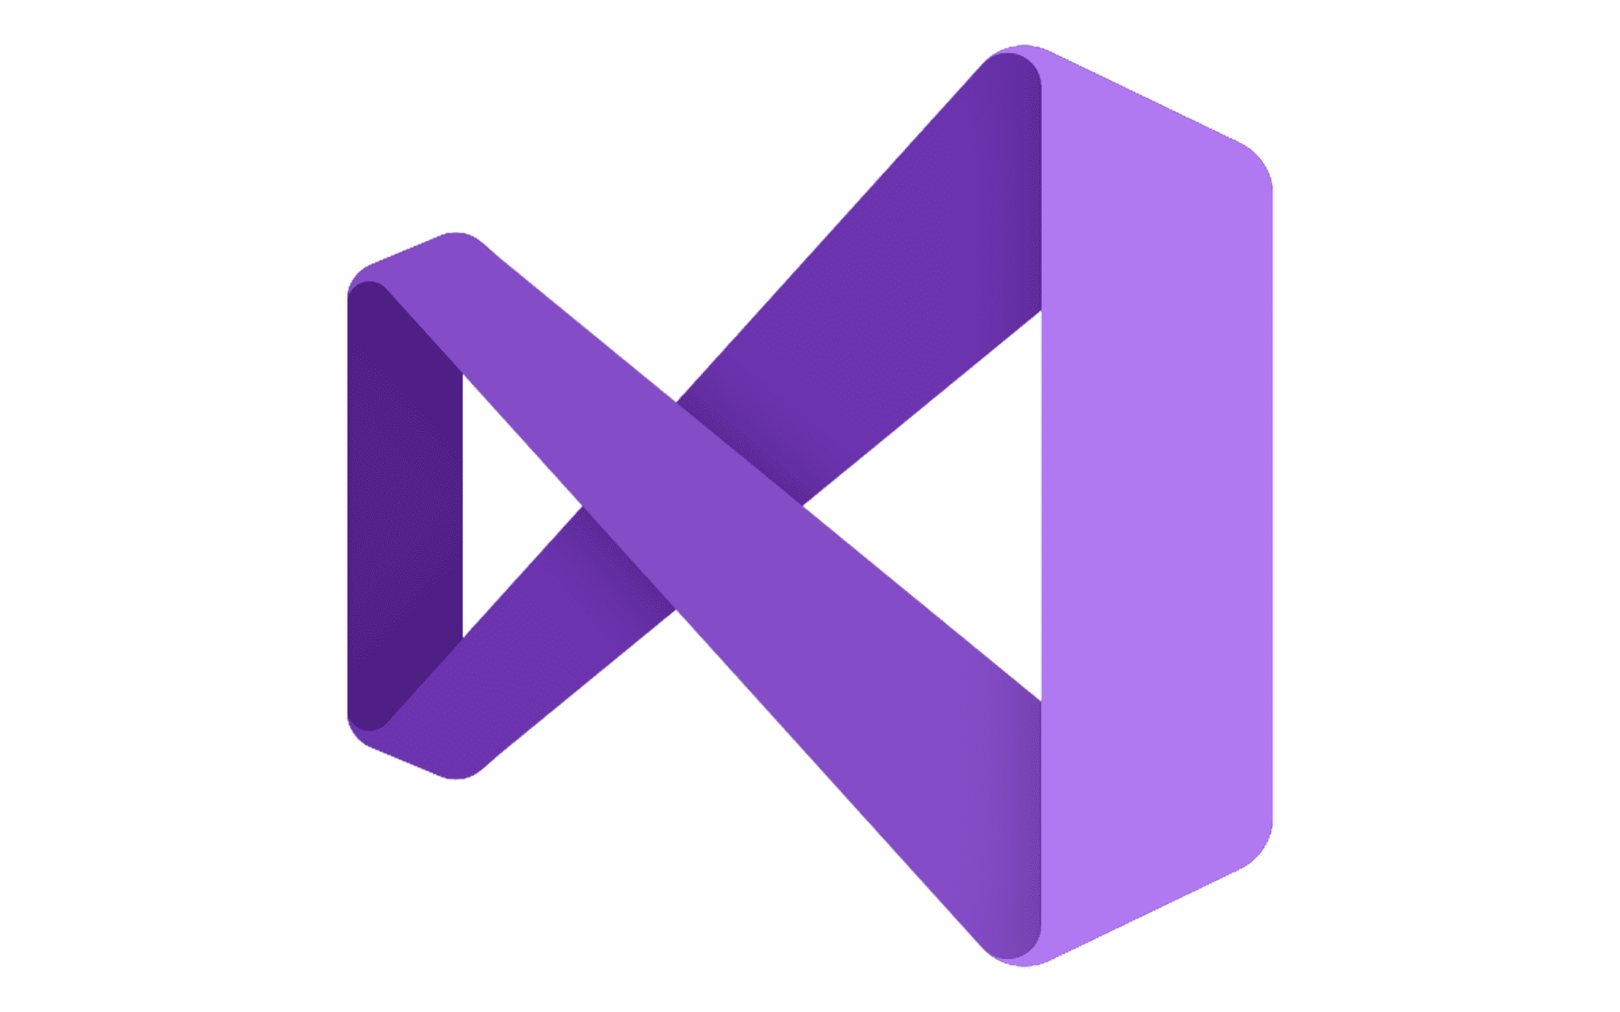



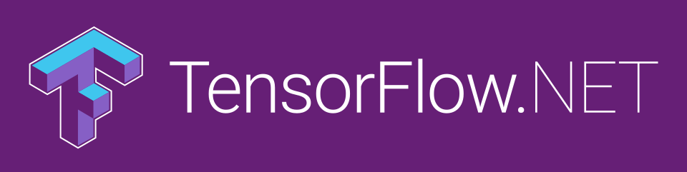



ML.NET Ecosystem
“”
ML.NET (Microsoft.ML)
AutoML (Microsoft.ML.AutoML)
Model Builder
ML.NET CLI
TorchSharp

Slide 54
What you learned?
What is ML.NET?
What can you do with ML.NET?
ML.NET Ecosystem

Slide 55
Introduction to Automated ML (AutoML)

Slide 56
What you will learn?
Machine Learning Training Workflow
What is Automated ML (AutoML)?
Train a custom ML model using AutoML

Slide 57
Machine Learning Training Workflow
Define problem
Prepare data
Choose algorithm
Tune Hyperparameters
Evaluate model

Slide 58
What is Automated Machine Learning (AutoML)?
Automated machine learning (AutoML) automates the process of applying machine learning to data.
Given a task and a dataset, you can run AutoML to interate over different data transformations, machine learning algorithms, and hyperparameters to select the best model.

Slide 59
Machine Learning Training Workflow (AutoML)
Define problem
Prepare data
AutoML

Slide 60
Samples: aka.ms/dotnet-ai-beginner

Slide 61
What you learned?
Machine Learning Training Workflow
What is Automated ML (AutoML)?
Train a custom ML model using AutoML

Slide 62
Train your own ML model Model Builder (ML.NET)

Slide 63
What you will learn?
What is Model Builder?
What can I do with Model Builder?
Train a custom ML model using Model Builder

Slide 64
Samples: aka.ms/dotnet-ai-beginner

Slide 65
What learned?
What is Model Builder?
What can I do with Model Builder?
Train a custom ML model using Model Builder

Slide 66
Train your own ML model Model Builder (ML.NET)

Slide 67
What you will learn?
Use Model Builder to generate consumption app for your model
Test your model
Deploy your model to Azure

Slide 68
Samples: aka.ms/dotnet-ai-beginner

Slide 69
What you learned?
Use Model Builder to generate consumption app for your model
Test your model
Deploy your model to Azure

